Slide 1
Formal Methods vs Machine Learning
Feb 2020
Luigia Petre,
Åbo Akademi University, Turku, Finland
Notes:
----- Meeting Notes (1.6.2015 09:47) -----
the language
the basic idea
an example
some rules

Slide 2
Some background
MSc in Computer Science, University of Bucharest 1997
PhD in Computer Science, Åbo Akademi University, 2005
Senior lecturer at Åbo Akademi University
Adjunct professor
Research in formal methods
Modeling based on math to analyze software systems
Teaching in data science, since 2018
CA17137 – gravitational waves with machine learning
Awesome physics (hard!)

Slide 3
Formal methods
What is a formal method?
Set of techniques for analysing software-based systems
Has
Language with semantics
Methods of formulating + evaluating properties
Method/s of comparing different versions of the same system
Examples
Z, B, Event-B, ASM, Alloy, VDM, TLA
CSP, CCS, pi-calculus, Ambient Calculus

Slide 4
Event-B: state-based formal method
States and transitions
States
Variables
Constants
Transitions (Events)
Guards: necessary conditions
Actions: some variables change
Certain abstraction level

Slide 5
Semantics
denote the relationship holding between the state variables of the machine just before (denoted by v) and after (denoted by v′) “applying” an assignment
if x are variables of the machine, then x′ are their values just after applying an assignment
y denotes the set of variables drawn from v which are distinct from those in x

Slide 6
Formal Reasoning
Invariant
Condition on the state variables that must hold permanently
We prove that, under the invariant in question and under the guard of each event, the invariant still holds after the variables have been modified according to the transition associated with that event
Reachability
Condition that does not hold permanently
We prove that, an event whose guard is not necessarily true now will nevertheless certainly occur within a finite number of iterations

Slide 7
Invariant preservation
axioms
invariant
guard
Before-after predicate
invariant
Where:
s sets, c constants, v variables, v’ variables after action takes place
∀-quantified over all carrier sets, constants, and variables occurring free in the proof obligation

Slide 8

Refinement as spatial extension
Reality is the same
Our view of the refined reality is more accurate
Previously invisible details of the reality are now revealed
More powerful microscope reveals even more details
A refined model is spatially larger than its previous abstractions

Slide 9
Spatial extension has corresponding temporal extension
The new variables can be modified by new transitions
Could not have been present in previous abstractions: the concerned variables did not exist in them
New events involve the new variables only
They refine some implicit events doing “nothing” in the abstraction
Refinement will thus result in a discrete observation of reality, which is now performed using a finer time granularity.

Slide 10
Wireless sensor-actor networks Partitions and recovery
Example 1
Main purpose of the algorithm:
→ Re-establish connections among partitions formed by an actor failure
A₃
A₁₁
A₁₅
A₂
A₁₀
A₁₄
A₄
A₁
A₆
A₁₂
A₁₃
A₇
A₈
A₅

Slide 11
Result for Example 1
A₃
A₁₁
A₁₅
A₂
A₁₀
A₉
A₁₄
A₄
A₁
A₆
A₁₂
A₁₃
A₇
A₈
A₅

Slide 12
Refinement overview
We show that recovery is possible when the sensors are in a transitive closure relation.

Slide 13
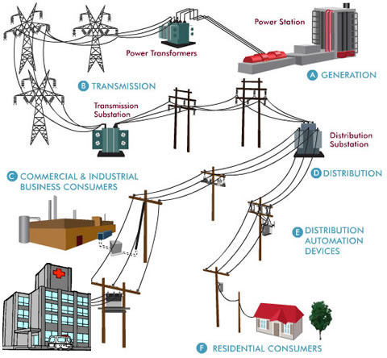
Example 2
Smart grid recovery from failures
Configurations
Momentary: tree
All possibilities: graph
Smart electrical grids modeling
Recovery
Reconfiguration
Reestablishment
Priorities
Hospitals/street lighting

Slide 14
Refinement overview

Slide 15
Summing up
The sciences do not try to explain, they hardly even try to interpret, they mainly make models.
John von Neumann
We aim at making correct models
With respect to the requirements
To analyze properties
What about machine learning?

Slide 16
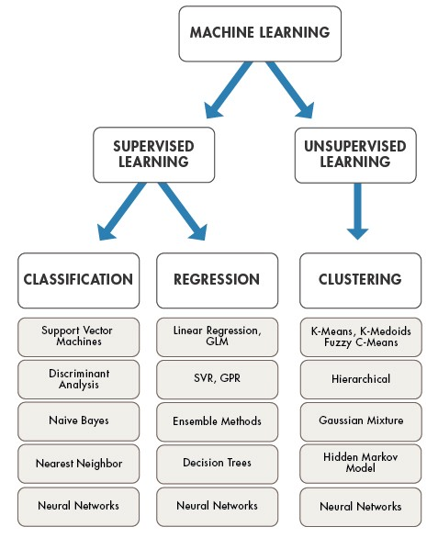

Machine Learning

Slide 17
Formal Methods vs Machine Learning
Deductive vs inductive approach
Max Planck Institute (Germany)
Can we learn invariants?
And then prove properties
Can we learn models?
And then invarants, and then prove
Correctness of ML algorithms
Linear regression vs deep learning

Slide 18
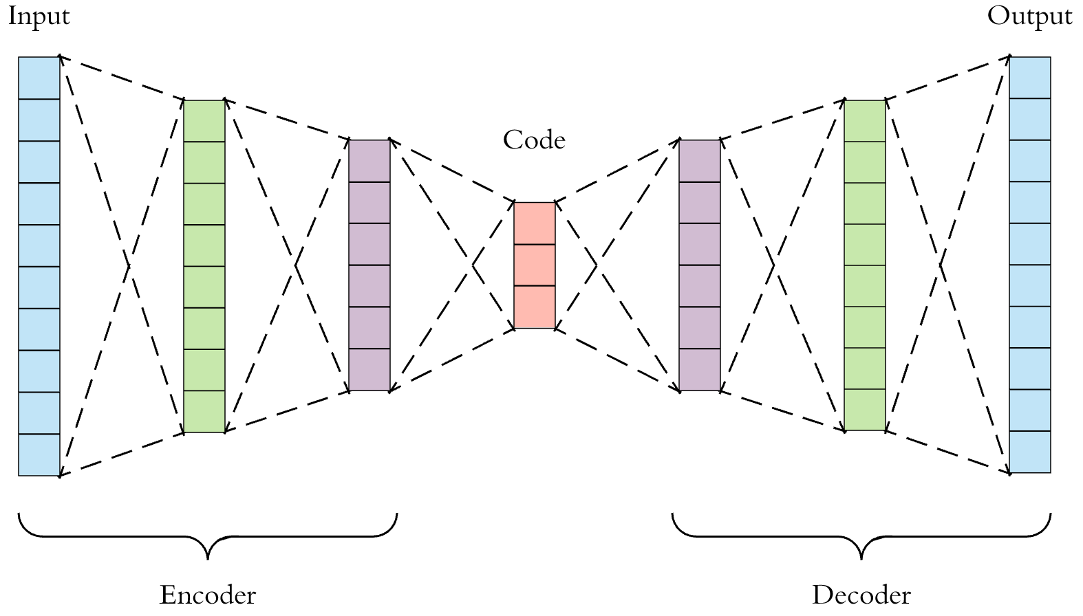
What about CA13137?
Autoencoder for GW
GW – the anomaly?
How about the latent space?
Can we learn something about the GW parameters from there?

